Slide 1
Interrupts
Muhammad Amin

Slide 2
A Question
The operating system
  Gets an input
  Performs a computation
  Produces an output
  And Quits
  Yes or no?
The answer: No
The operating system is a Reactive Program.
Jan 30, 2024
Operating Systems - Muhammad Amin

Slide 3
Operating System
Modern Operating Systems are Interrupt driven
If
  No process to execute
  No I/O device to service
  No user to whom to respond
Then
  OS will sit quietly, waiting for something to happen
This something is Interrupt
At a particular time either a user program is running or operating system is running
  Pseudo-Parallelism
Jan 30, 2024
Operating Systems - Muhammad Amin

Slide 4
CPU Cycle now is:
Fetch Next
Instruction
Decode Instruction
Execute Instruction
Check for Interrupt:
Process Interrupt
Start
Halt
Jan 30, 2024
Operating Systems - Muhammad Amin

Slide 5
Interrupt Handling
Different routines handle different type of interrupts.
  Called Interrupt Service Routine (ISR)
When the CPU is interrupted it stops what it is doing
The address of the interrupted instruction is saved
A generic routine is run
  This routine examines the nature of interrupt
  Calls the corresponding ISR
The ISR’s are usually stored in the lower part of the memory
After the interrupt is serviced, the saved address is loaded to the Program Counter
The Interrupted computation can resume as though the interrupt had not occurred.
Incoming interrupts are disabled while another interrupt is being processed to prevent a lost interrupt
Jan 30, 2024
Operating Systems - Muhammad Amin

Slide 6
Interrupt Handling
A trap is a software-generated interrupt caused either by an error or a user request
An operating system is interrupt driven
Determines which type of interrupt has occurred:
  polling
  vectored interrupt system
Jan 30, 2024
Operating Systems - Muhammad Amin

Slide 7
Classes of Interrupts
Program
  division by zero
  execute illegal instruction
  reference outside user’s memory space
Timer
I/O
  Generated when a program issues an input or output request
Hardware failure
A temporary problem:
  E.g., the subroutine is not in the memory
Jan 30, 2024
Operating Systems - Muhammad Amin

Slide 8
Computer System
Consists of CPU and device controllers
Connected through a common Bus.
Providing access to shared memory
  Disk drives
  Audio devices
  Video display
Jan 30, 2024
Operating Systems - Muhammad Amin

Slide 9

Computer System
Synchronize access to memory
Jan 30, 2024
Operating Systems - Muhammad Amin

Slide 10
Device Controllers
I/O devices generally consists of two parts:
  An Electronic component
    Device Controller
  A Mechanical component
    the device itself
Each device controller is in charge of a specific device
It maintains
  Some local storage buffer
  A set of special purpose register
Accepts command from the Operating System
For example to read data from the device.
Jan 30, 2024
Operating Systems - Muhammad Amin

Slide 11
Device Controllers
A Device controller might accept a command:
  Read Sector 11,206
The device controller would:
  Determine the current position of the head
  Move the head to the required location
  Accept data bit by bit
  Store in a local buffer
  Perform checksum on the data
Controllers contain small embedded programs to carry out all this work.
Jan 30, 2024
Operating Systems - Muhammad Amin

Slide 12
Device Drivers
Who would initiate the controller?
Who would determine read/write?
Who would tell the sector number?
A part of operating system called Device Driver
Software or Hardware?
  Software that talks to a controller
  Gives it command
  Accept Responses
Same for all controllers?
  Different software for different type of controllers
  Each controller manufacturer has to supply a driver for each operating system it supports
Jan 30, 2024
Operating Systems - Muhammad Amin

Slide 13
I/O Interrupts
I/O requested by user program
Control transferred to OS
The Device Driver loads appropriate registers within the device controller
The device controller examines their contents
  If Read request: Transfer data from device to local buffer
Once the data transfer is complete informs the CPU by interrupt
Jan 30, 2024
Operating Systems - Muhammad Amin

Slide 14
1. Synchronous I/O
The OS makes the CPU wait till the I/O complete interrupt is generated
How can a CPU wait, somehow it has to do F->D->E ??
  Wait can be accomplished by jumping to an infinite loop code in OS:
    Loop: jump Loop
If the devices does not support interrupts
  They will just set a flag in their register to indicate I/O complete
  The above loop would require to include Polling such devices as well
Jan 30, 2024
Operating Systems - Muhammad Amin

Slide 15
1. Synchronous I/O
If the CPU always has to wait for the I/O completion then the number of outstanding I/O requests is?
  Exactly One
So, whenever the I/O complete interrupt is generated the O/S knows the source device
Drawback:
  Excludes concurrent I/O operations to several devices
Jan 30, 2024
Operating Systems - Muhammad Amin

Slide 16
1. Synchronous I/O
Issues Read command to I/O module
CPU -> I/O
Read status of I/O module
I/O -> CPU
Not
Ready
Check Status
Error Condition
Ready
Read word from I/O module
I/O -> CPU
Write word into memory
CPU -> memory
No
Done?
Jan 30, 2024
Yes
Operating Systems - Muhammad Amin
Next Instruction

Slide 17
2. Asynchronous I/O
Start the I/O request
Return control immediately to the user process
If the current user program can’t run without the I/O, let the current process wait
Schedule some other user program or operating system code
If no process ready to run, then still need the idle loop
Jan 30, 2024
Operating Systems - Muhammad Amin

Slide 18
2. Asynchronous I/O
The number of outstanding I/O requests is?
  More than One
Need to keep track of multiple I/O requests
Jan 30, 2024
Operating Systems - Muhammad Amin

Slide 19
2. Asynchronous I/O
Issues Read command to I/O module
CPU -> I/O
Do something else
I/O -> CPU
Interrupt
Read status of I/O module
Check Status
Error Condition
Ready
Read word from I/O module
I/O -> CPU
Write word into memory
CPU -> memory
No
Done?
Jan 30, 2024
Yes
Operating Systems - Muhammad Amin
Next Instruction

Slide 20
Device Status Table
One entry per I/O device
Keeps record of
  Device’s type
  State
    Not functioning
    Idle
    Busy
If the device is busy, the new request is saved in a queue
Jan 30, 2024
Operating Systems - Muhammad Amin

Slide 21

Device Status Table
Jan 30, 2024
Operating Systems - Muhammad Amin

Slide 22
2. Asynchronous I/O
The I/O controller interrupts when it needs to be serviced
The OS determines the I/O controller
Processor reads the word of data from I/O controller to the memory
Updates the status in the Device Status table
In case of I/O complete interrupt, checks the additional request
The control is returned to the user program
Jan 30, 2024
Operating Systems - Muhammad Amin

Slide 23
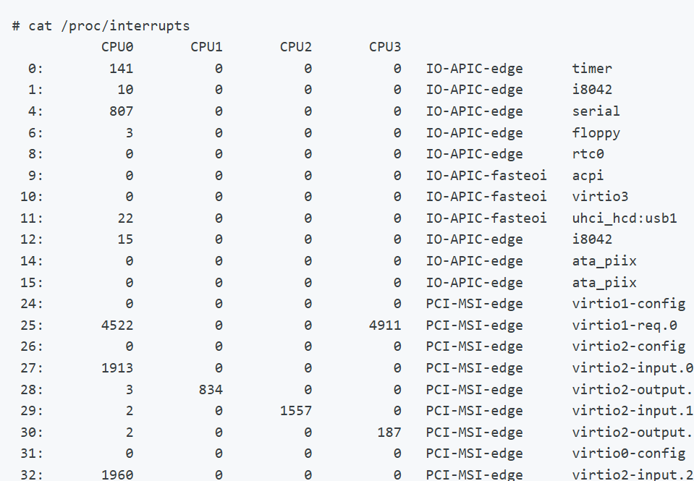
System processing interrupts are recorded in the /proc/interrupts file.
Jan 30, 2024
Operating Systems - Muhammad Amin

Slide 24
3. Direct Memory Access
Drawback of Asynchronous I/O:
  Any data transfer must traverse a path through the processor
In case of DMA, the following info to the DMA module:
  Read or Write request
  Address of the I/O device
  Starting location in memory to read from or write to
  Number of words
The DMA module is then asked to start data transfer
The above operations are performed by Device Driver
Jan 30, 2024
Operating Systems - Muhammad Amin

Slide 25
3. Direct Memory Access
The processor can continue with its work
The DMA module transfer data directly from the device to the main memory
But how many accesses to memory are possible at a time:
  Just one
In order to do so, it has to “steal” cycles from processor - Cycle Stealing
Since, only one access to memory is possible at a time
Jan 30, 2024
Operating Systems - Muhammad Amin

Slide 26
3. Direct Memory Access
The processor has to wait in the meanwhile
  This would slow down the processor
But still more efficient than the previous two cases
After the block transfer is completed, a single I/O interrupt will be generated by the DMA module.
Jan 30, 2024
Operating Systems - Muhammad Amin

Slide 27
Issues Read command to I/O module
CPU -> DMA
Do something
else
Read status
of DMA
module
Interrupt
DMA -> CPU
Yes
Next Instruction
Direct Memory Access
Jan 30, 2024
Operating Systems - Muhammad Amin

